Slide 1
Scaled Agile Framework (or SAFe)

Slide 2
SAFe
Scaled Agile Framework (or SAFe) is an Agile software development framework designed by Scaled Agile, Inc. It consists of a knowledge base of integrated patterns intended for enterprise-scale Lean-Agile development. Its proponents consider SAFe to be scalable and modular, allowing an organization to apply it in a way that suits its need.

Slide 3
SAFe Lean-Agile principles
1 - Take an economic view
2 - Apply systems thinking
3 - Assume variability; preserve options
4 - Build incrementally with fast, integrated learning cycles
5 - Base milestones on objective evaluation of working systems
6 - Visualize and limit WIP, reduce batch sizes, and manage queue lengths
7 - Apply cadence, synchronize with cross-domain planning
8 - Unlock the intrinsic motivation of knowledge workers
9 - Decentralize decision-making
Notes:
So let's discuss the Lean-Agile principles that underlie SAFe.
[Read through each of the principles on the slide]
We don't have time in presentation to drill into each of these, but if you head down the SAFe journey, it will be important to learn why these principles are so critical to a successful implementation of SAFe.
They are so important because principles trump practices.
So if we're struggling with a practice, we're going to return to these basic principles to make sure that we're trying to build a system and an implementation that is as Lean and Agile as possible.

Slide 4







SAFe
Building incrementally accelerates value delivery
Incremental
Delivery

Slide 5
Levels
There are two different types of SAFe 4.0 implementation, 3-Level SAFe and 4-Level SAFe. 3-Level SAFe is for smaller implementations with 100 people or less, or multiple such programs that do not require significant collaboration. 4-Level SAFe is for solutions that typically require many hundreds of practitioners to develop, deploy and maintain.
The levels in 3-Level SAFe are Team, Program & Portfolio.

Slide 6
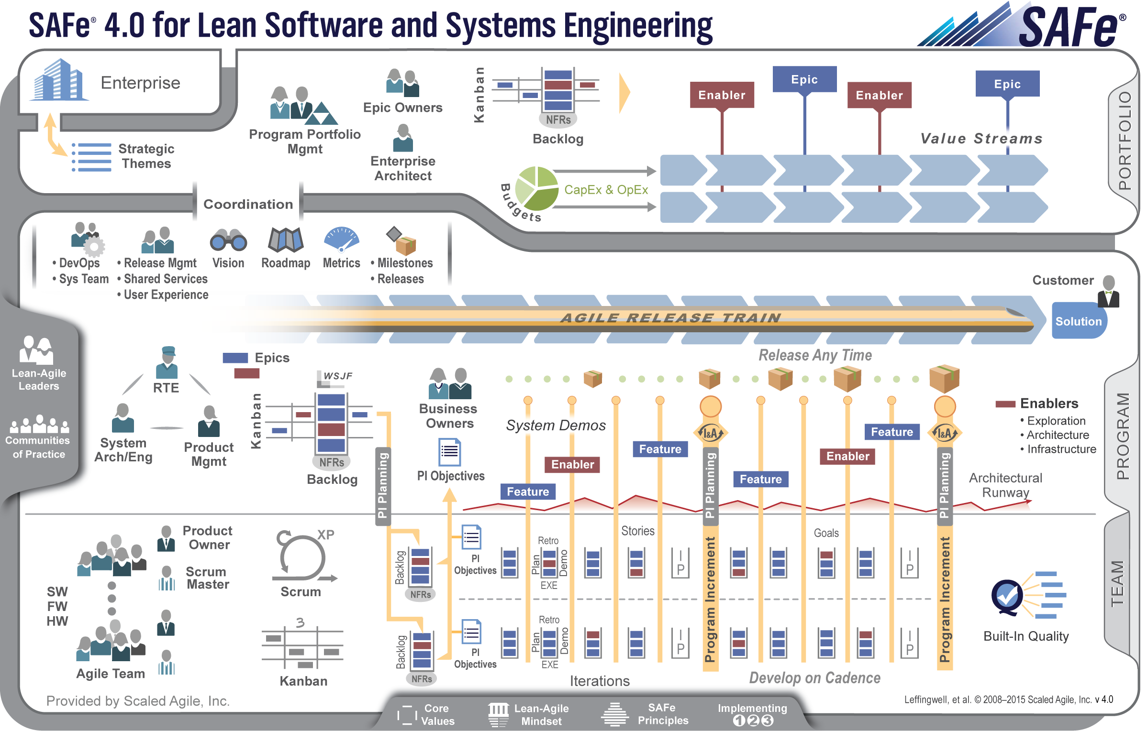
Three-level SAFe 4.0

Slide 7

Applies test automation
Test automation supports rapid regression testing
Test 1
Test 2
Test 3
Test 4
Test 5
…
Test 1
Test 2
Test 3
Test 4
Test 5
…
Implemented in the same iteration
Maintained under version control
Passing vs. not-yet-passing and broken automated tests are the real
iteration progress indicator
✗
Progress
Done
Building functionality
Test automation
Iteration

Slide 8
Team
Cross-functional, self-organizing entities that can define, build and test a thing of value
Applies basic scientific practice: Plan—Do—Check—Adjust
Delivers value every two weeks
Do
Check
Adjust
Plan
PDCA

Slide 9
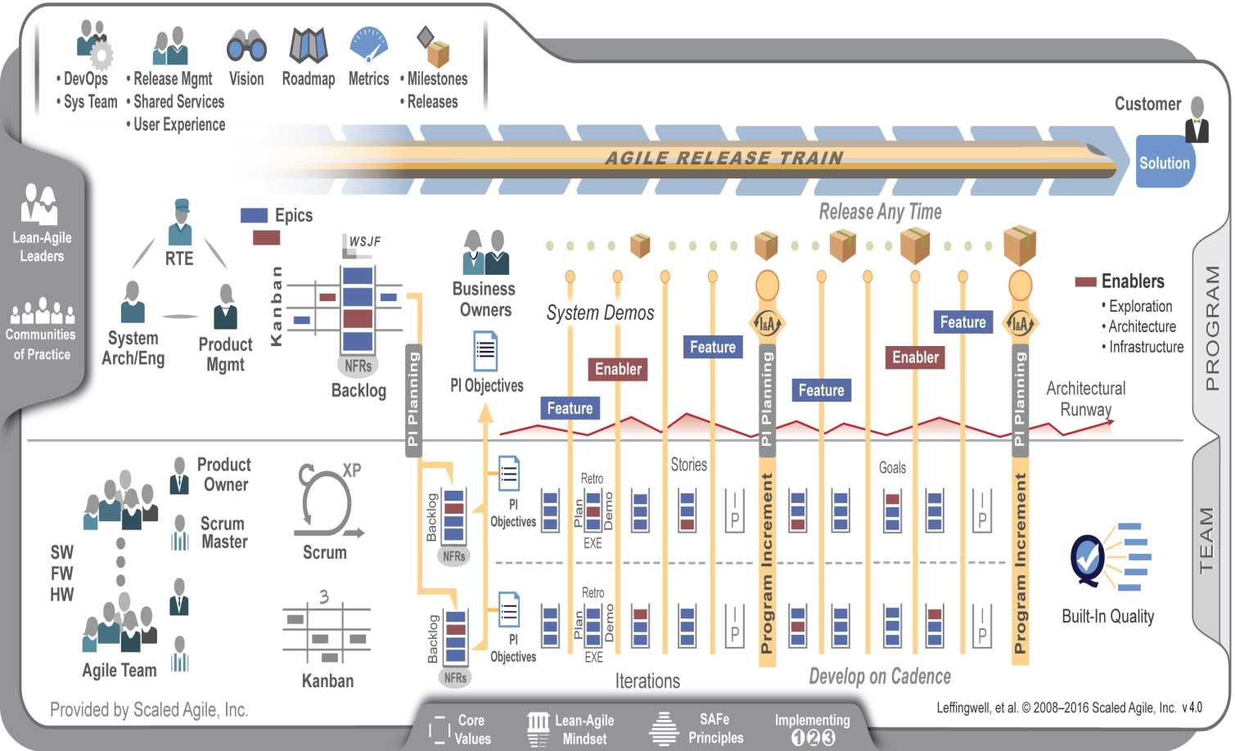
Agile Teams
Align 50-125 practitioners to a common mission
Apply cadence and synchronization, Program Increments every 6-12 weeks
Provide Vision, Roadmap, architectural guidance

Slide 10
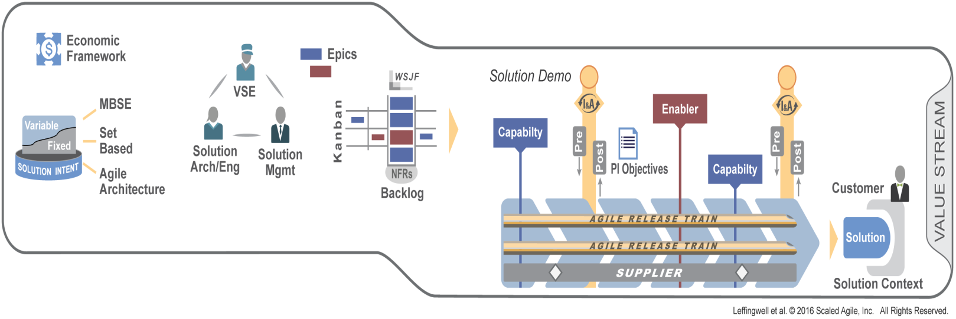
New 4.0 Value Stream level
Apply cadence and synchronization
Establish local governance with Value Stream roles and Economic Framework
Manage fixed and variable Solution Intent
Manage the flow of Capabilities with the Value Stream Kanban
Frequently integrate and validate Customer solutions

Slide 11
Results
Happier, more motivated employees
30 – 75% faster time to market
ENGAGEMENT
TIME TO MARKET
PRODUCTIVITY
BUSINESS RESULTS
QUALITY
20 – 50% increase in productivity
50%+ defect reduction

